Slide 1
Digital image processing
Yu Zepeng 2020/9/17

Slide 2
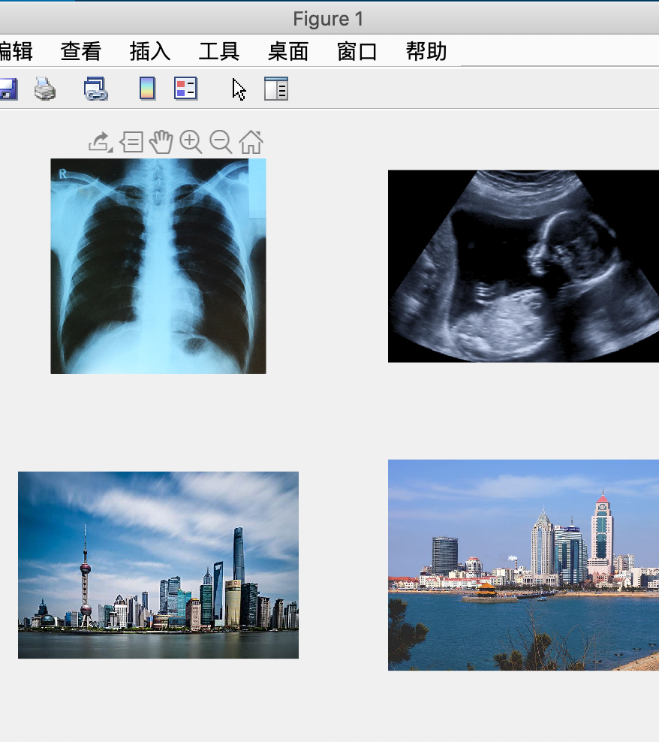
1
Code:
im1 = im2double(imread(‘images/chest.jpg'));
im2 = im2double(imread(‘images/baby.jpg'));
im3 = im2double(imread(‘images/shanghai.jpeg'));
im4 = im2double(imread(‘images/qingdao.jpeg'));

Slide 3
2
Code:
im1_ycbcr = rgb2ycbcr(im1);
im2_ycbcr = rgb2ycbcr(im2);
im3_ycbcr = rgb2ycbcr(im3);
im4_ycbcr = rgb2ycbcr(im4);
y1 = im1_ycbcr(:,:,1);
y2 = im2_ycbcr(:,:,1);
y3 = im3_ycbcr(:,:,1);
y4 = im4_ycbcr(:,:,1);

Slide 4
3
y1_n = imnoise(y1,'gaussian');
y2_n = imnoise(y2,'gaussian');
y3_n = imnoise(y3,'gaussian');
y4_n = imnoise(y4,'gaussian');
figure();
subplot(2,2,1); imshow(y1_n);
subplot(2,2,2); imshow(y2_n);
subplot(2,2,3); imshow(y3_n);
subplot(2,2,4); imshow(y4_n);

Slide 5
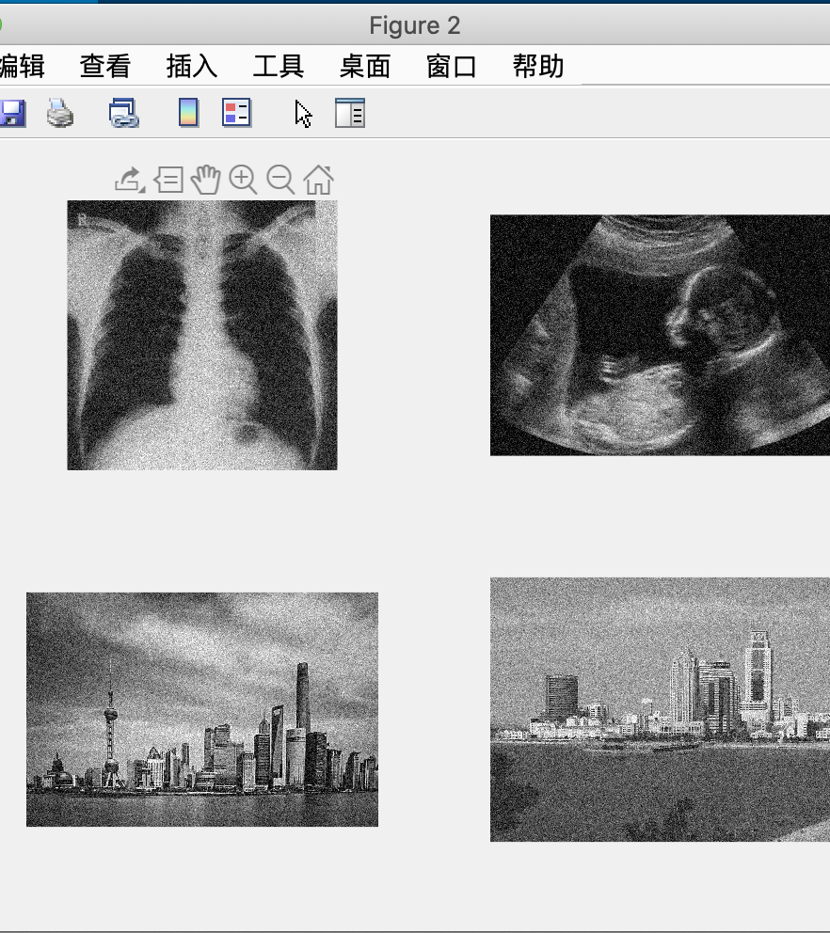
Result
Add Gaussian noise to the image.

Slide 6
4
function [im_dct,n,xo,yo,xq,yq,original,quadrant] = ddct(im)
s = size(im');
im_dct = dct2(im);
original = im_dct.*im_dct;
quadrant = im_dct(400:end,344:end).*im_dct(400:end,344:end);
s_o = size(original');
s_q = size(quadrant');
xo = [1:s_o(1)];
yo = [1:s_o(2)];
xq = [1:s_q(1)];
yq = [1:s_q(2)];
[xo,yo] = meshgrid(xo,yo);
[xq,yq] = meshgrid(xq,yq);
n = mean(mean(quadrant));
end

Slide 7
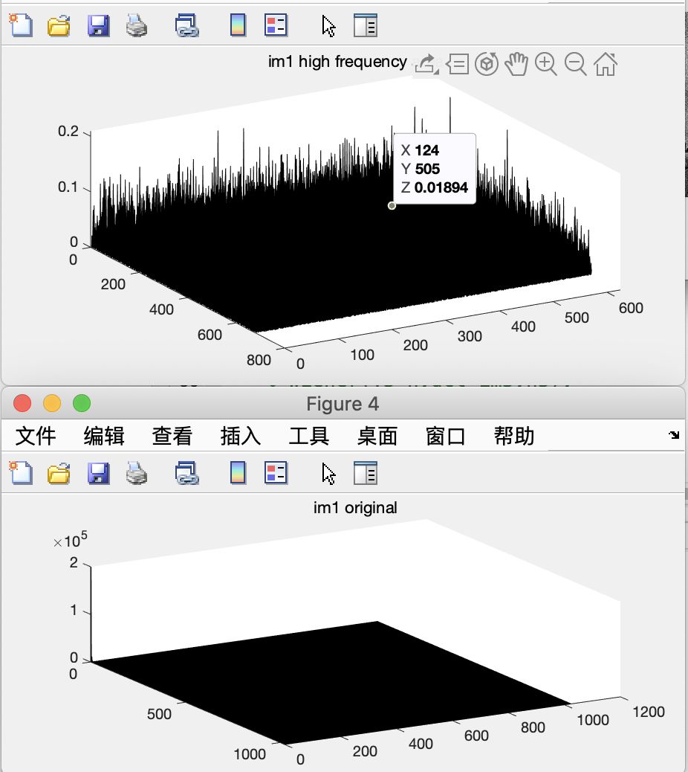
Result

Slide 8
5
function wiener(im1,im2,n)
s_var = im2.*im2 + 0.001;
wiener_filter = 1./(1 + (n./s_var));
dct_f = im2.*wiener_filter;
dct_f_im = idct2(dct_f);
dct_f_im = 255.*imadjust(dct_f_im,[],[0,1]);
figure();
imshowpair(im1,uint8(dct_f_im),'montage');title('left:noisy image right:DCT Wiener Filter');
end

Slide 9
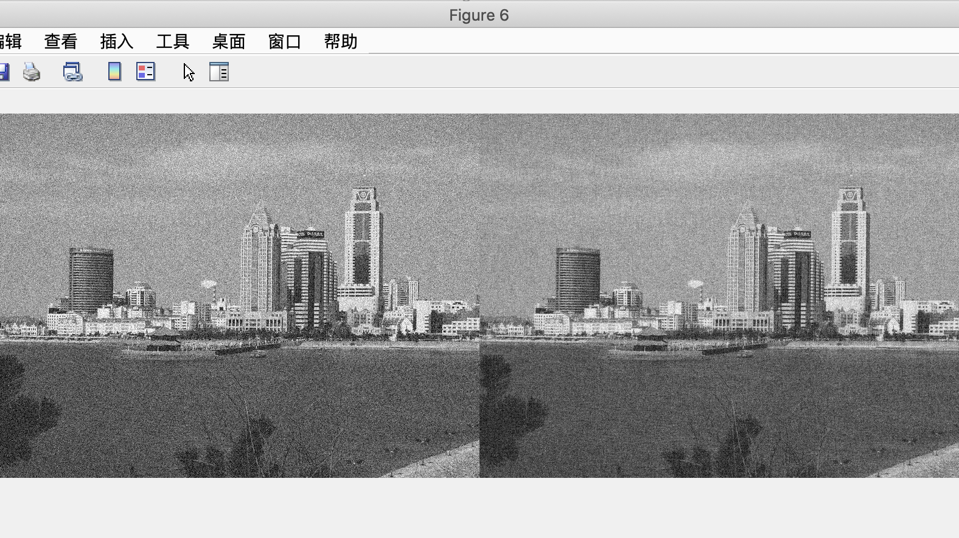

Slide 10
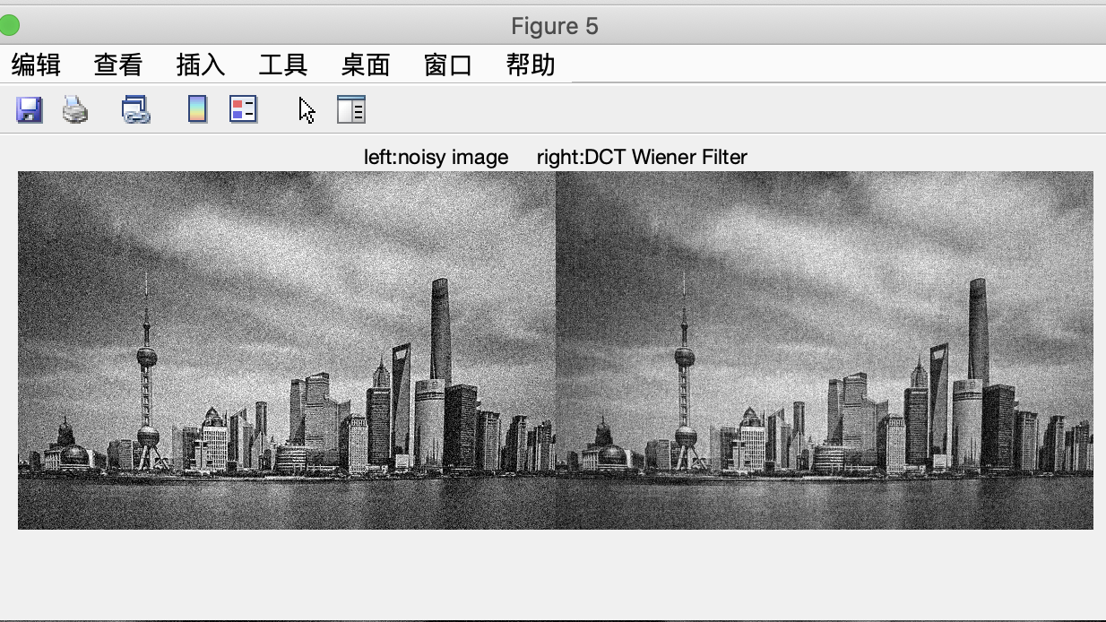

Slide 11
6
function MyEdges(y)
edge_s = edge(y,'sobel');
edge_r = edge(y,'roberts');
edge_p = edge(y,'prewitt');
edge_c = edge(y,'canny');
figure();
subplot(2,2,1);imshow(edge_s);title('Sodel');
subplot(2,2,2);imshow(edge_r);title('Roberts');
subplot(2,2,3);imshow(edge_p);title('Prewitt');
subplot(2,2,4);imshow(edge_c);title('Canny');
end

Slide 12
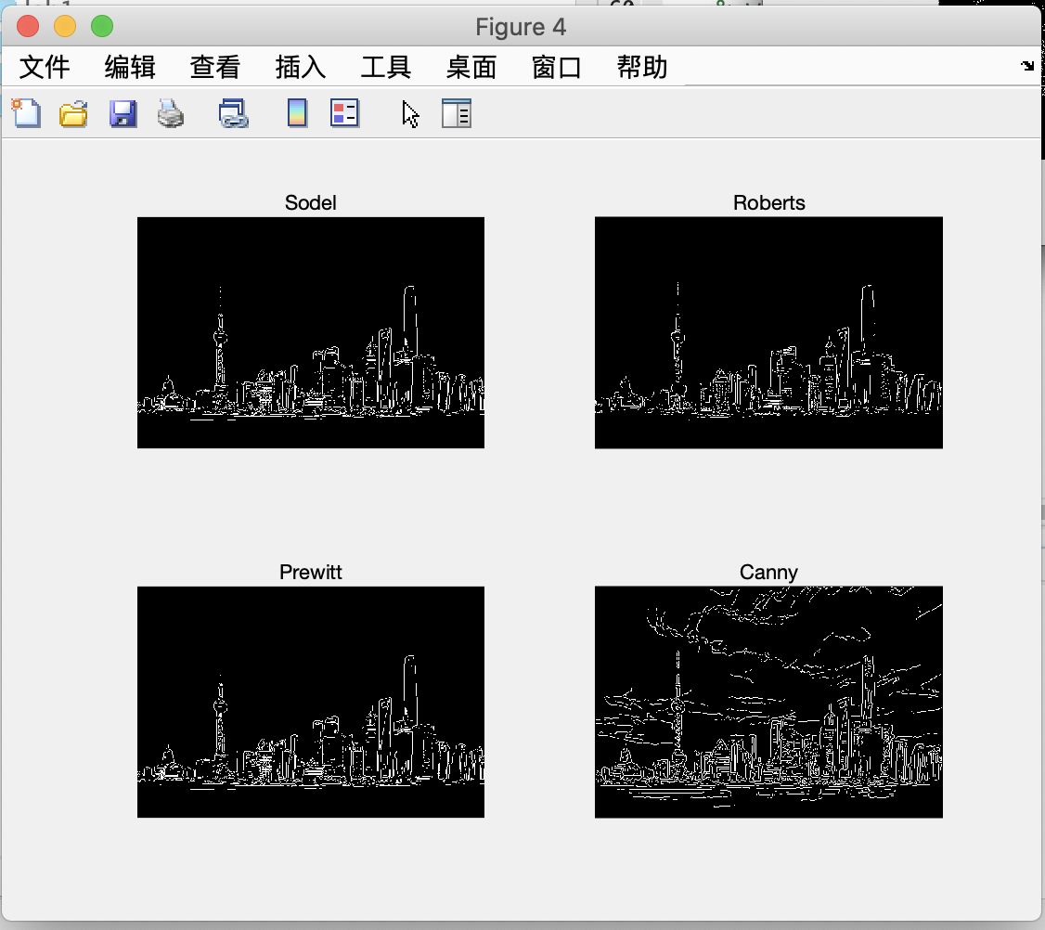
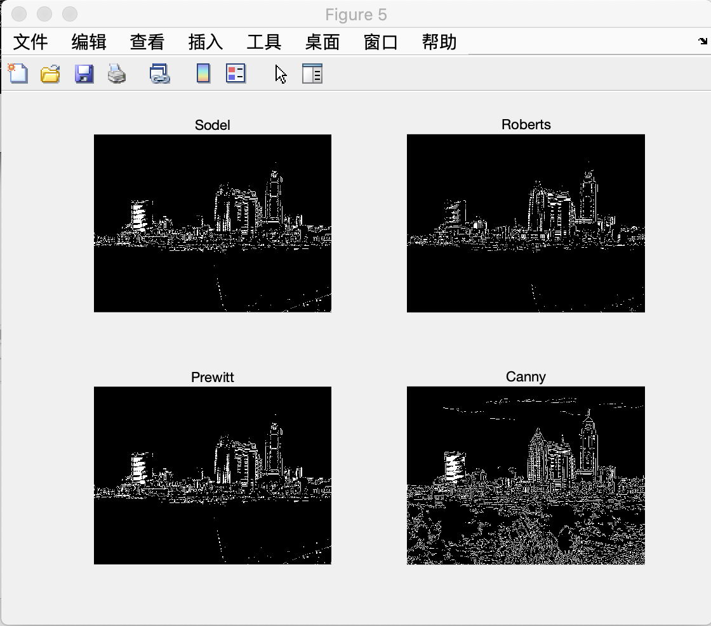
Result

Slide 13
7
%Value for Thresholding
T_Low = 0.095;
T_High = 0.1;

Slide 14
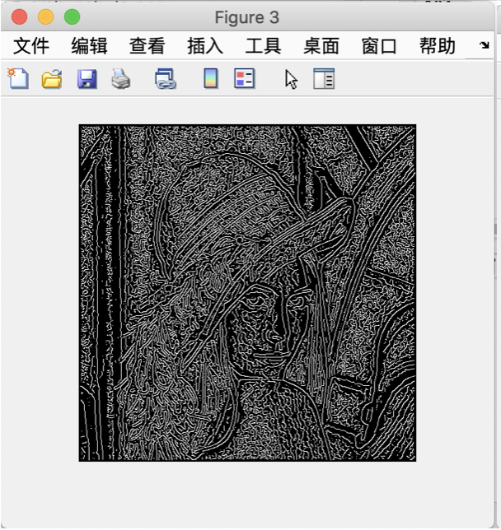
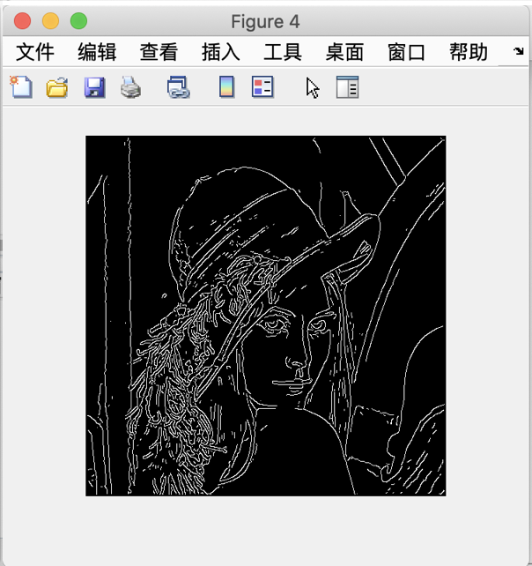
Result

Slide 15
8
%Value for Thresholding
T_Low = 0.09;
T_High = 0.3;

Slide 16
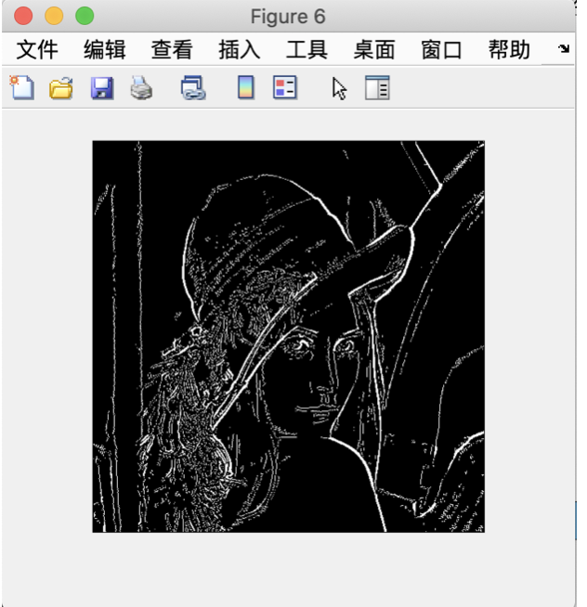
Result & 9
The image in the 8 is clearer than the image in the 7, because the line in the 8 is thinner. We can see more detail in the 8.

Slide 17
10
I = imread('images/building.jpg');
I = rgb2gray(I);
rotI = imrotate(I,0,'crop');
subplot 221
fig1 = imshow(rotI);
BW = edge(rotI,'canny');
title(‘original image');
subplot 222
imshow(BW);
[H,theta,rho] = hough(BW);
title(‘edge detect');
subplot 223
imshow(imadjust(mat2gray(H)),[],'XData',theta,'YData',rho,...
'InitialMagnification','fit');

Slide 18
xlabel('\theta (degrees)'), ylabel('\rho');
axis on, axis normal, hold on;
colormap(hot)
P = houghpeaks(H,5,'threshold',ceil(0.7*max(H(:))));
x = theta(P(:,2));
y = rho(P(:,1));
plot(x,y,'s','color','black');
lines = houghlines(BW,theta,rho,P,'FillGap',5,'MinLength',7);
title(‘Hough space');
subplot 224, imshow(rotI), hold on
max_len = 0;
for k = 1:length(lines)
xy = [lines(k).point1; lines(k).point2];
plot(xy(:,1),xy(:,2),'LineWidth',2,'Color','green');
% Plot beginnings and ends of lines
plot(xy(1,1),xy(1,2),'x','LineWidth',2,'Color','yellow');
plot(xy(2,1),xy(2,2),'x','LineWidth',2,'Color','red');
% Determine the endpoints of the longest line segment
len = norm(lines(k).point1 - lines(k).point2);
if ( len > max_len)
max_len = len;
xy_long = xy;
end
end
% highlight the longest line segment
plot(xy_long(:,1),xy_long(:,2),'LineWidth',2,'Color','red');
title(‘line detect’);

Slide 19
11
Y channel: img(:,:,1)
Cb channel: img(:,:,2)
Cr channel: img(:,:,3)

Slide 20
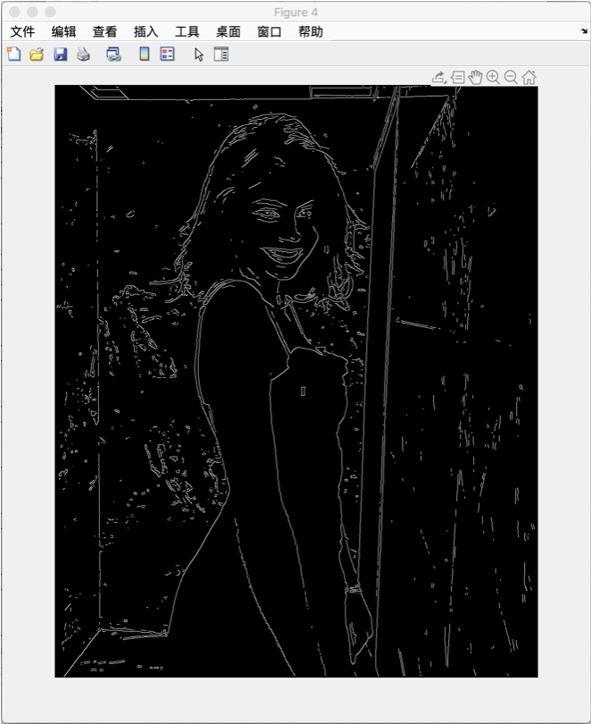
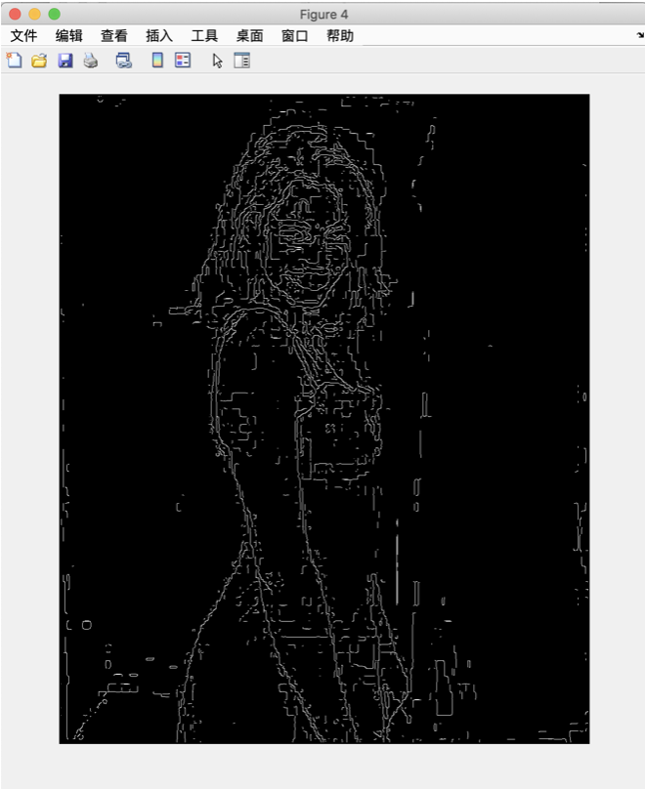
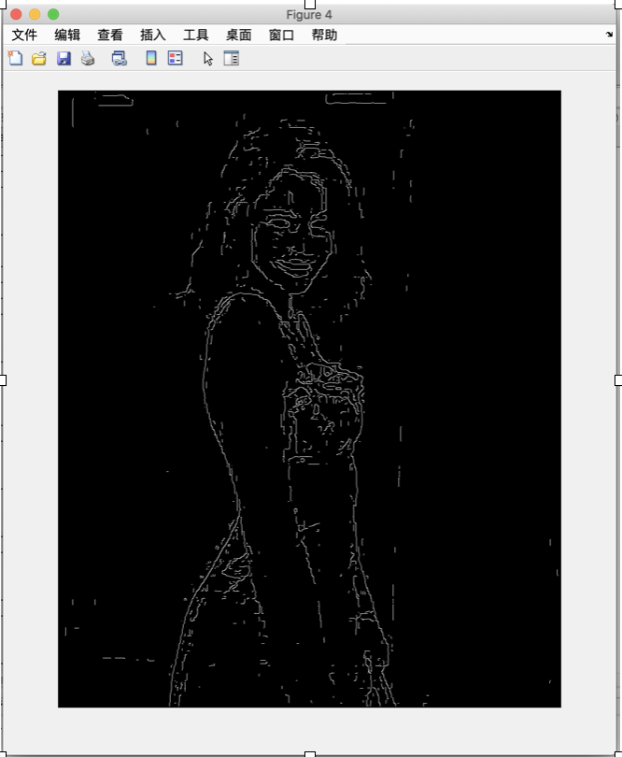
Result
Y channel
Cb channel
Cr channel

Slide 21
We can easily find a face in Y channel, but we can hardly recognize a face in Cb and Cr channel.

Slide 22
12
[c,s]=wavedec2(X,4,’haar'); % add 2 level
[H3,V3,D3] = detcoef2('all',c,s,3);
A3 = appcoef2(c,s,'haar',3);
V3img = wcodemat(V3,255,'mat',1);
H3img = wcodemat(H3,255,'mat',1);
D3img = wcodemat(D3,255,'mat',1);
A3img = wcodemat(A3,255,'mat',1);
[H4,V4,D4] = detcoef2('all',c,s,4);
A4 = appcoef2(c,s,'haar',4);
V4img = wcodemat(V4,255,'mat',1);
H4img = wcodemat(H4,255,'mat',1);
D4img = wcodemat(D4,255,'mat',1);
A4img = wcodemat(A4,255,'mat',1);

Slide 23
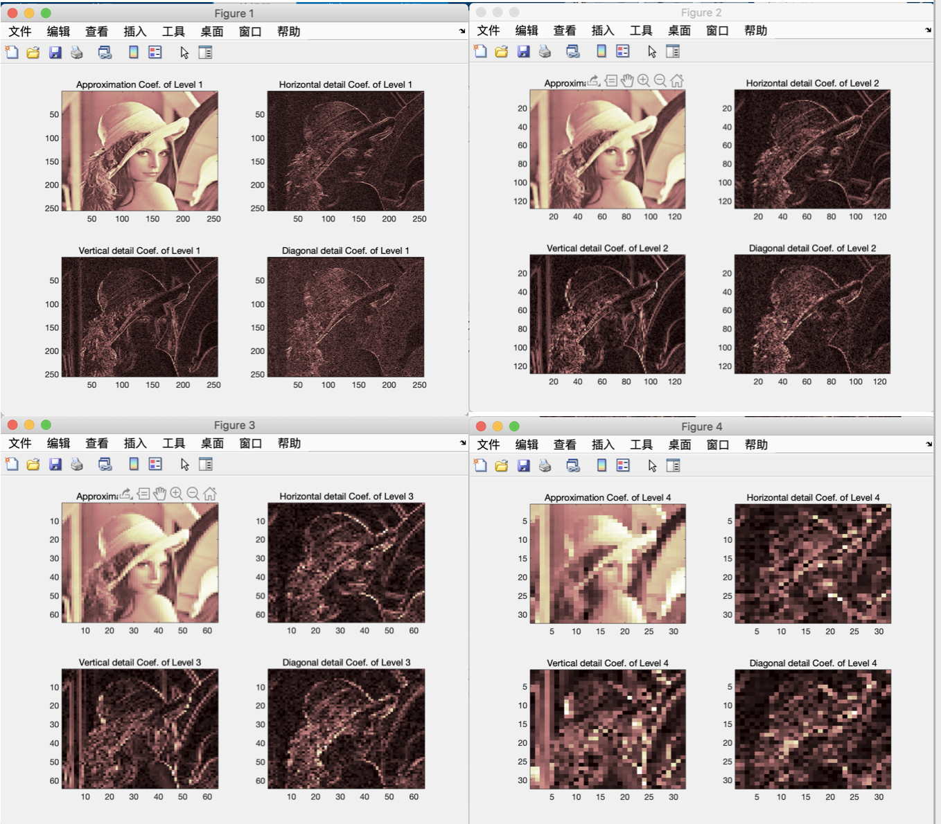
Result

Slide 24
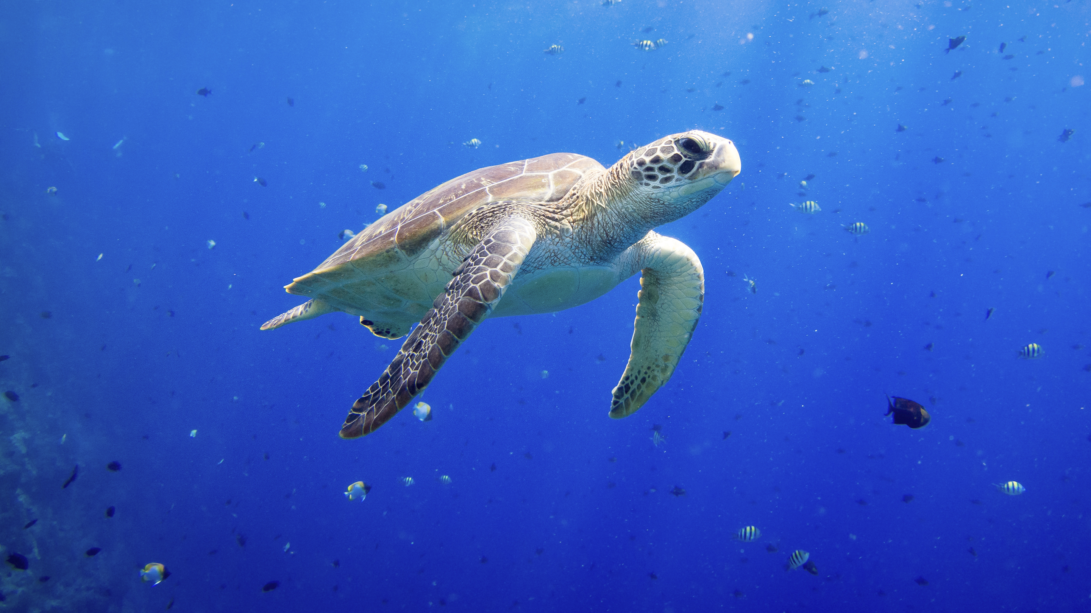
Thanks for listening
Yu zepeng

